Slide 1




IQUEUE PROJECT
Giacomelli Gianluca, 10615105
Gottardini Andrea, 10617000
Veronese Niccolò Enrico, 10620278
Software engineering for automation (2022-2023)
We have created some mock-ups to show an example of suitable user interface of our iqueue project.
Professors:
Rossi Matteo Giovanni
Lestingi Livia

Slide 2
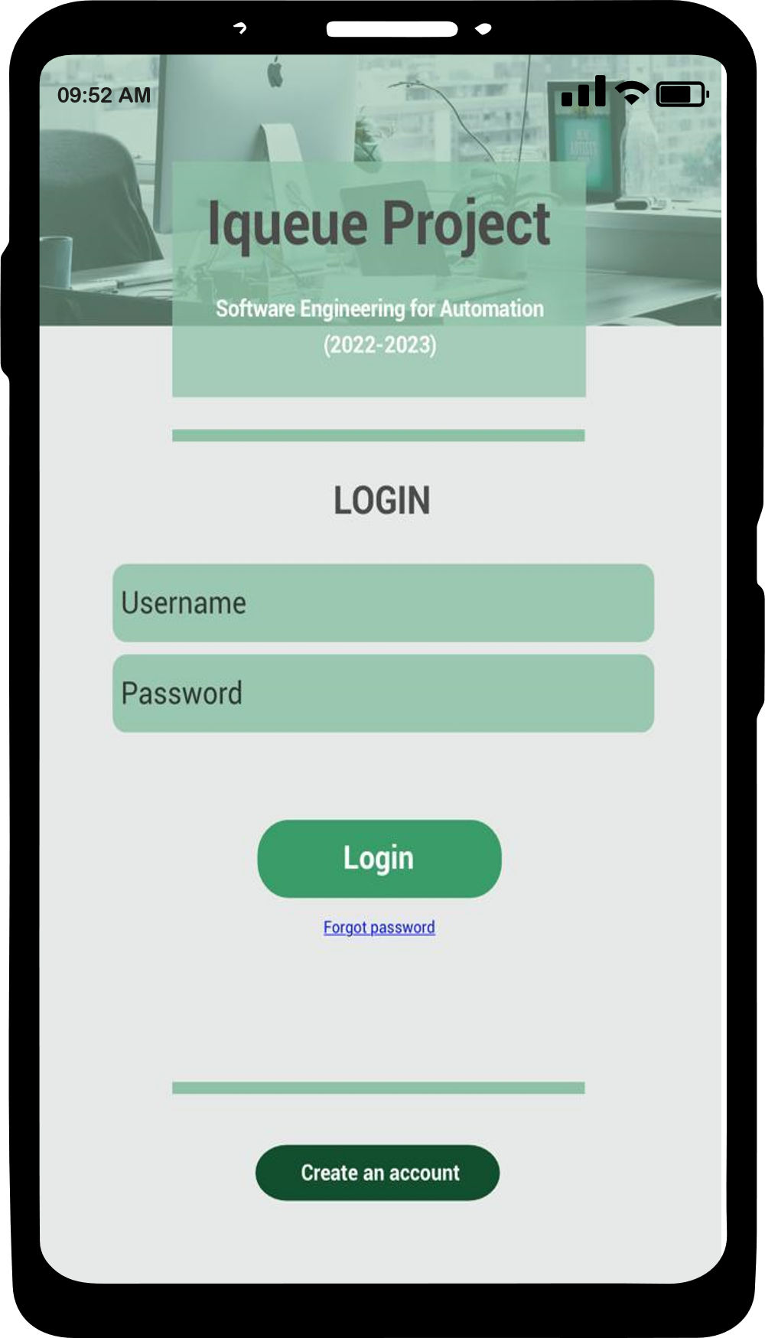
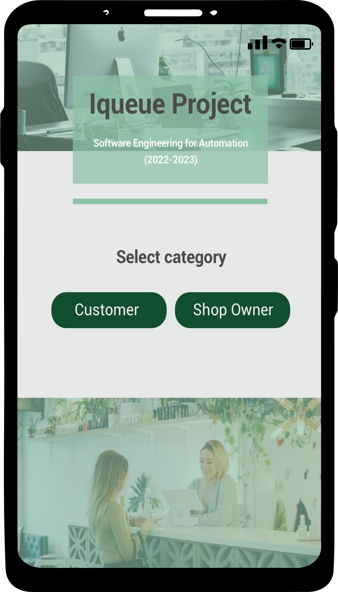
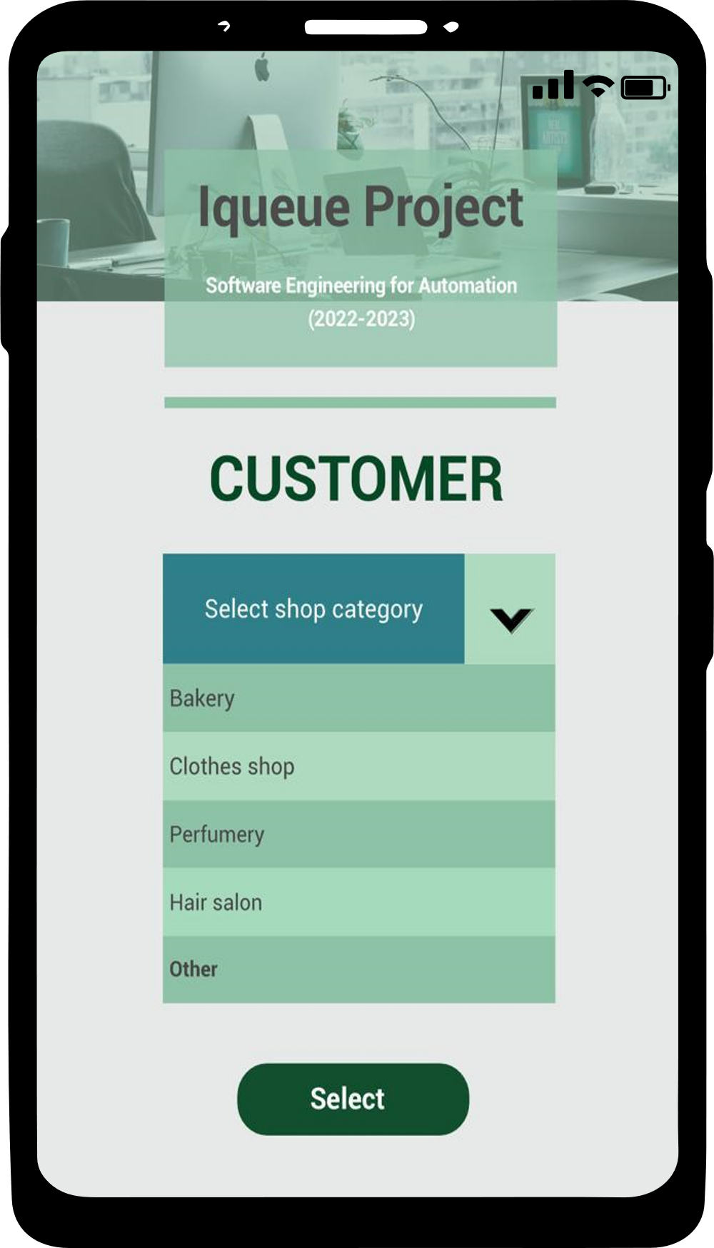
2: page in which the user selects whether to act as a customer or a shop owner
3: page that allows the customer to select the shop category he wants to visit
1: initial page of the system

Slide 3
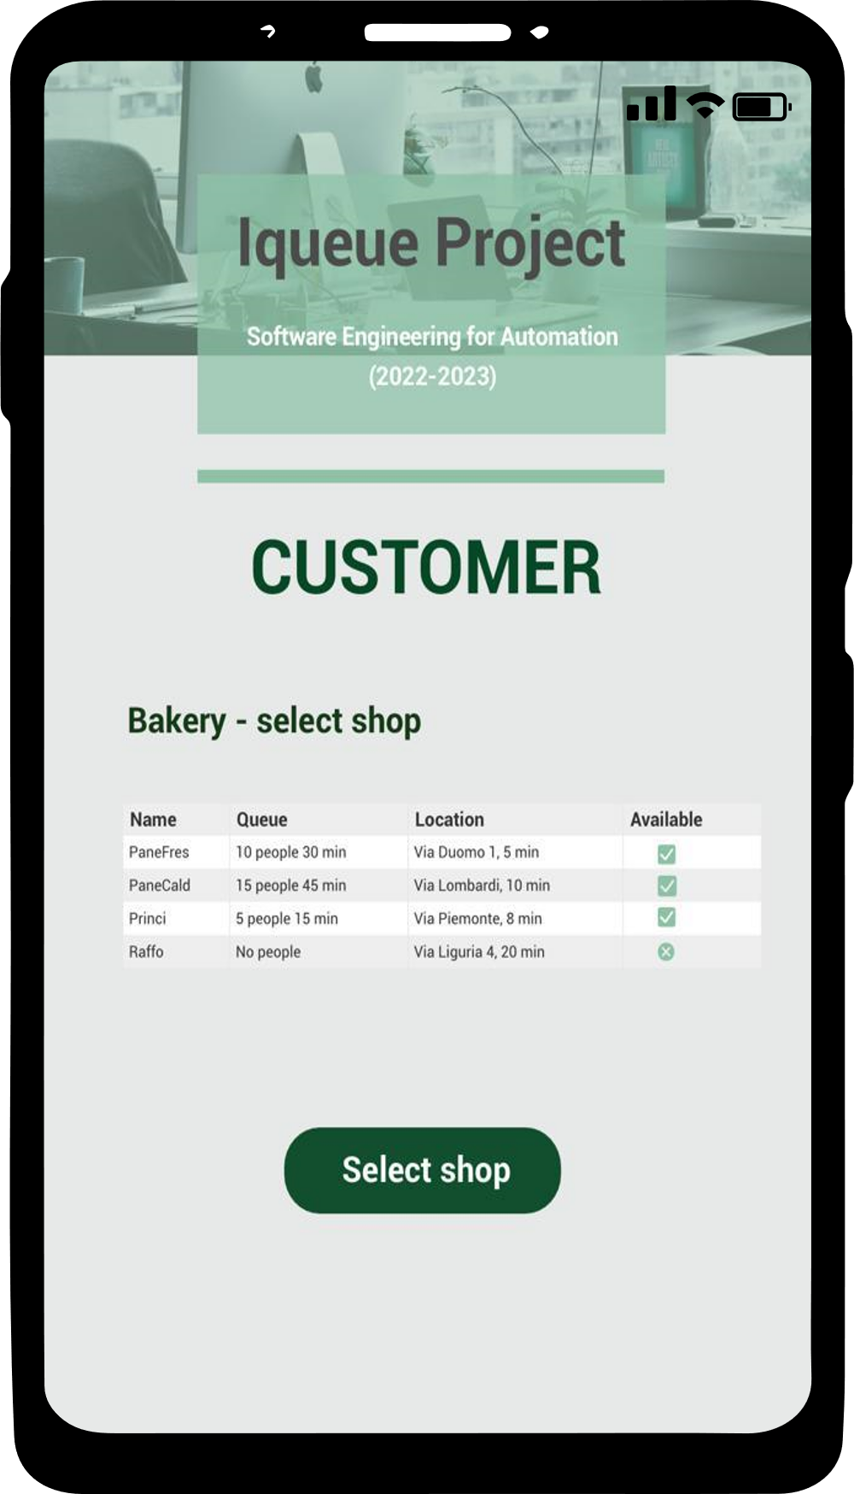
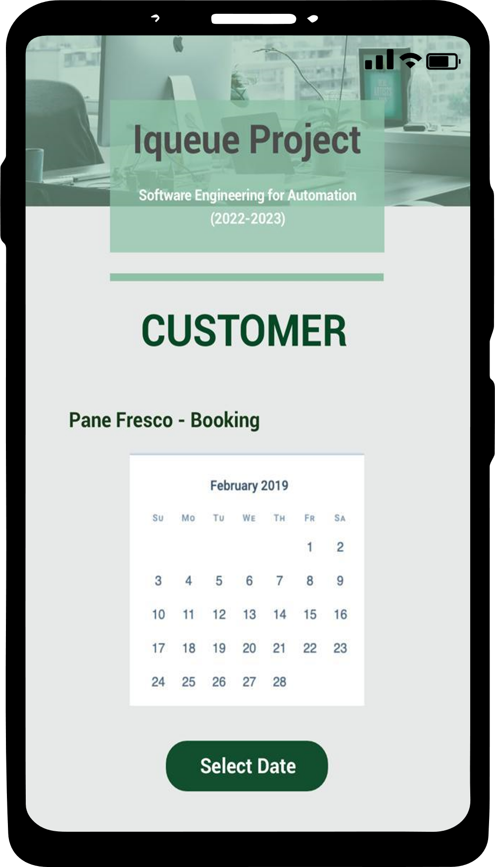
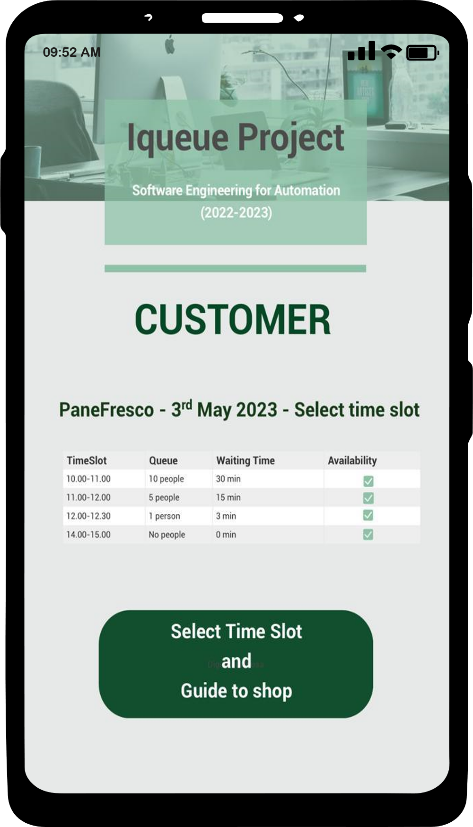
4: page that allows the customer to select the shop he wants to go, given the category chosen before, the number of people in queue at the shop in that moment, the waiting time in that moment, the location, the time needed to reach the place and the availability of the shop
6: page that allows the customer to select the time slot to go to the selected shop. Once pushed the button, the Iqueue app will open the GPS system to guide the customer to the desired location.
5: page that allows the customer to select the date he wants to go to the previously selected shop

Slide 4
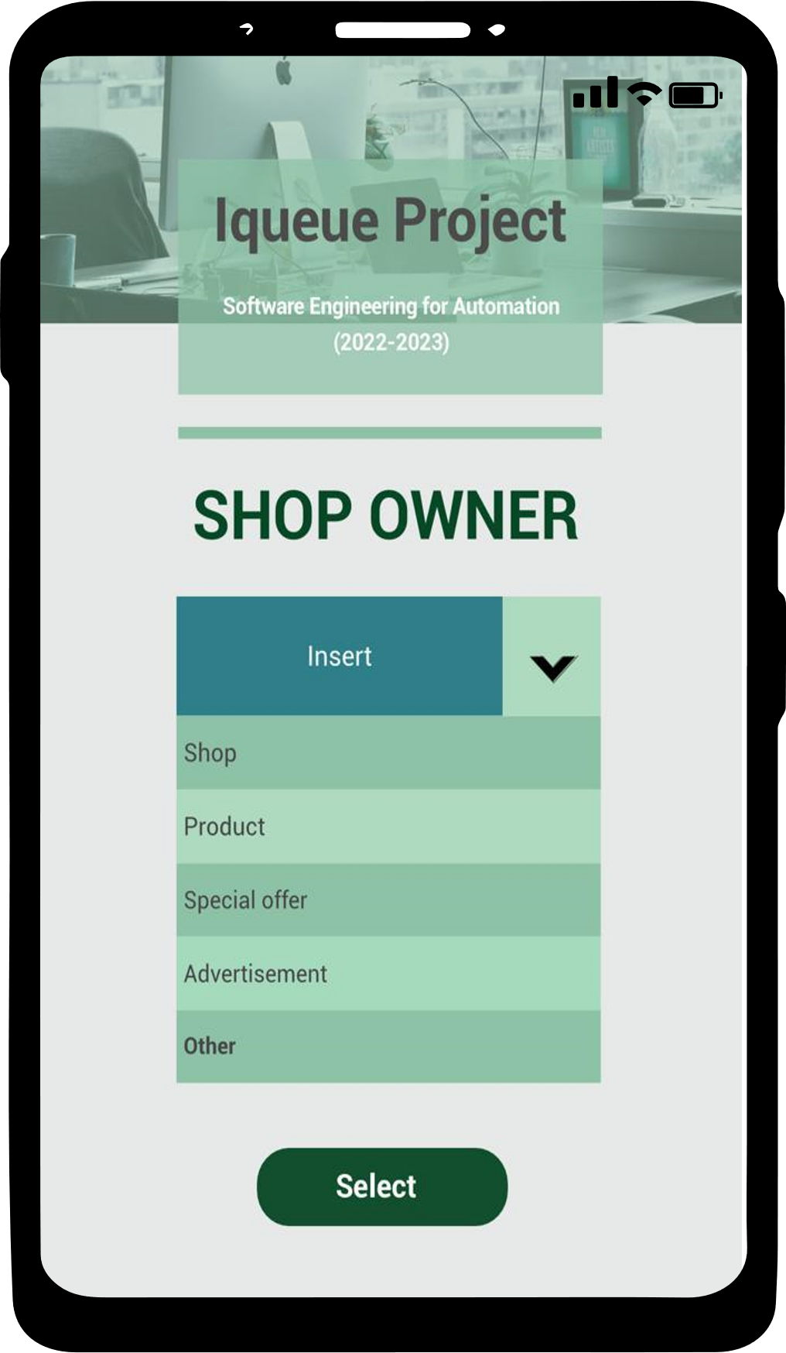
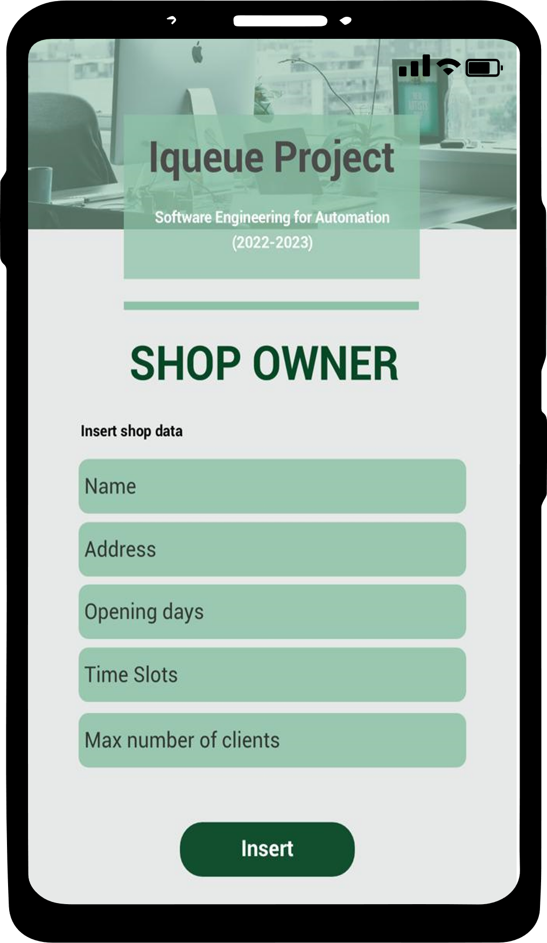
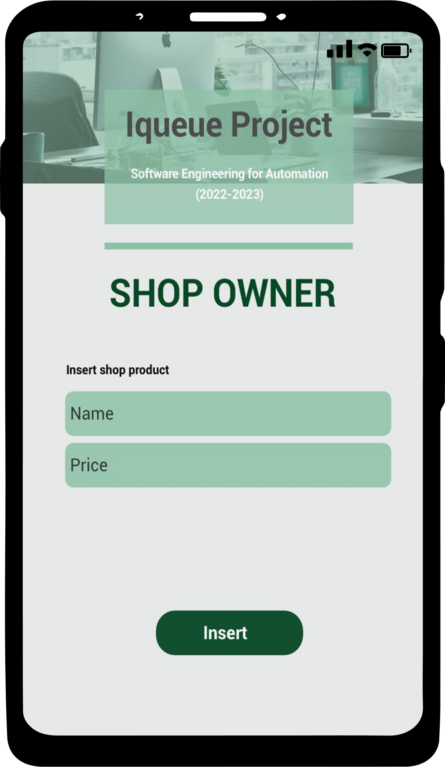
7: page that allows the Shop Owner to choose what type of information insert into the Iqueue app. The possible choices could be: Shop, Product, Special offer, Advertisement
8: page that allows the Shop Owner to insert the shop data
9: page that allows the Shop Owner to insert the shop product data

